Slide 2
Fun with JS proxies
Goran Šiška
Head of QA @ Adacta

Slide 3
ComeFrom
Edsger Dijkstra's Go To Statement Considered Harmful.
R. Lawrence Clark’s We don't know where to GOTO if we don't know where we've COME FROM…

Slide 4
ComeFrom
5 INPUT X
10 PRINT 'Result is :’
15 PRINT X
20 COME FROM 10
25 X = X * X
30 RETURN

Slide 5
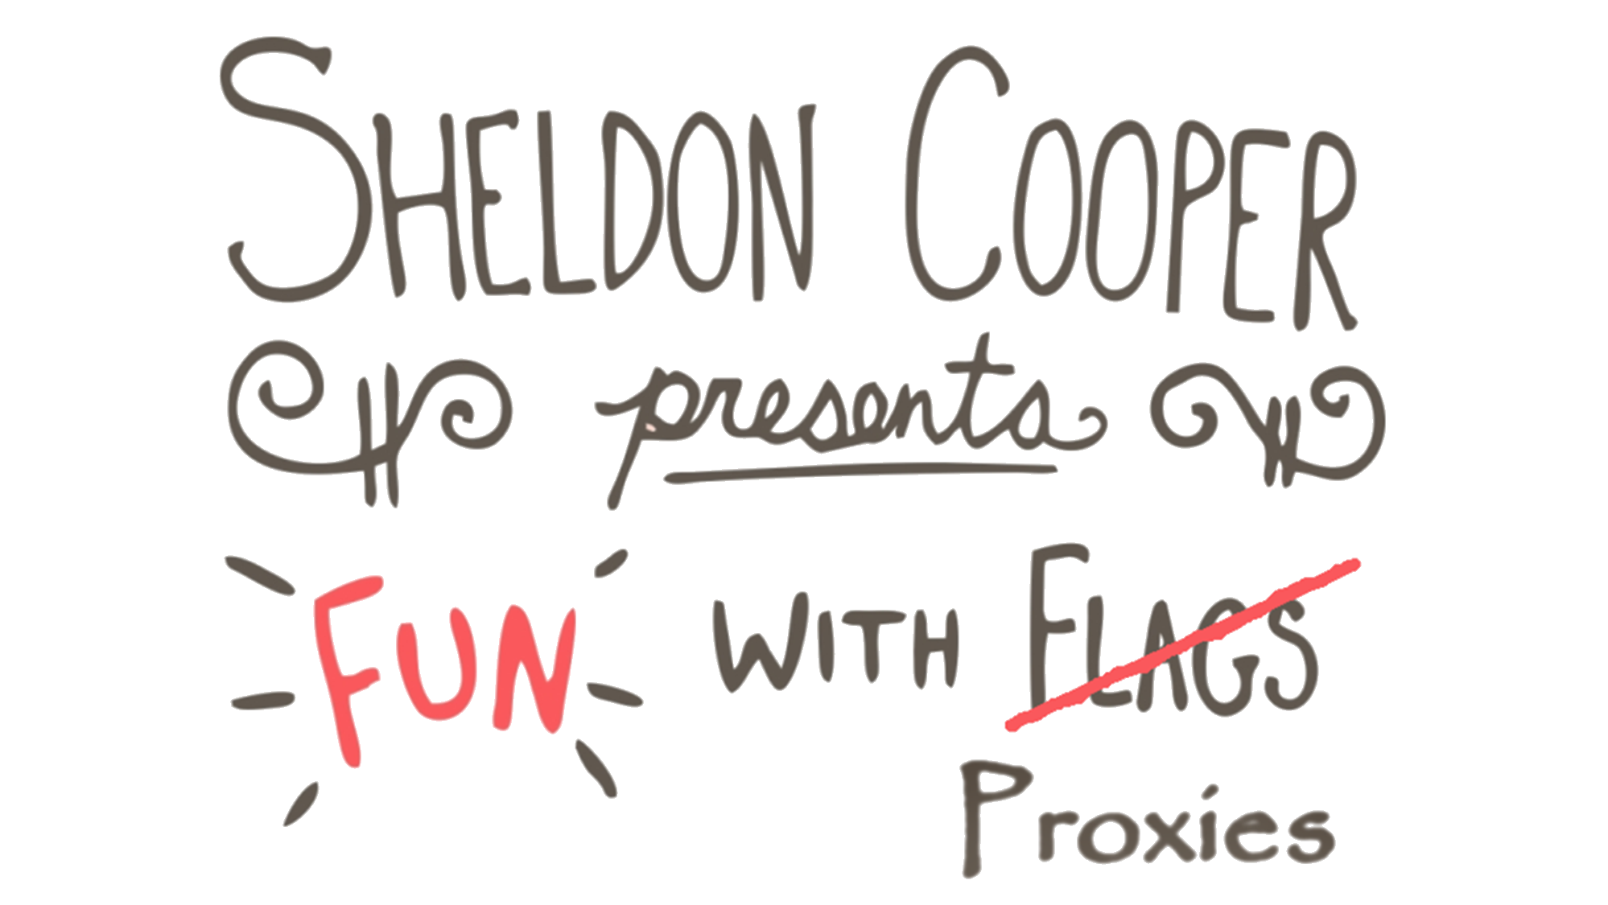

#ntk23

Slide 6
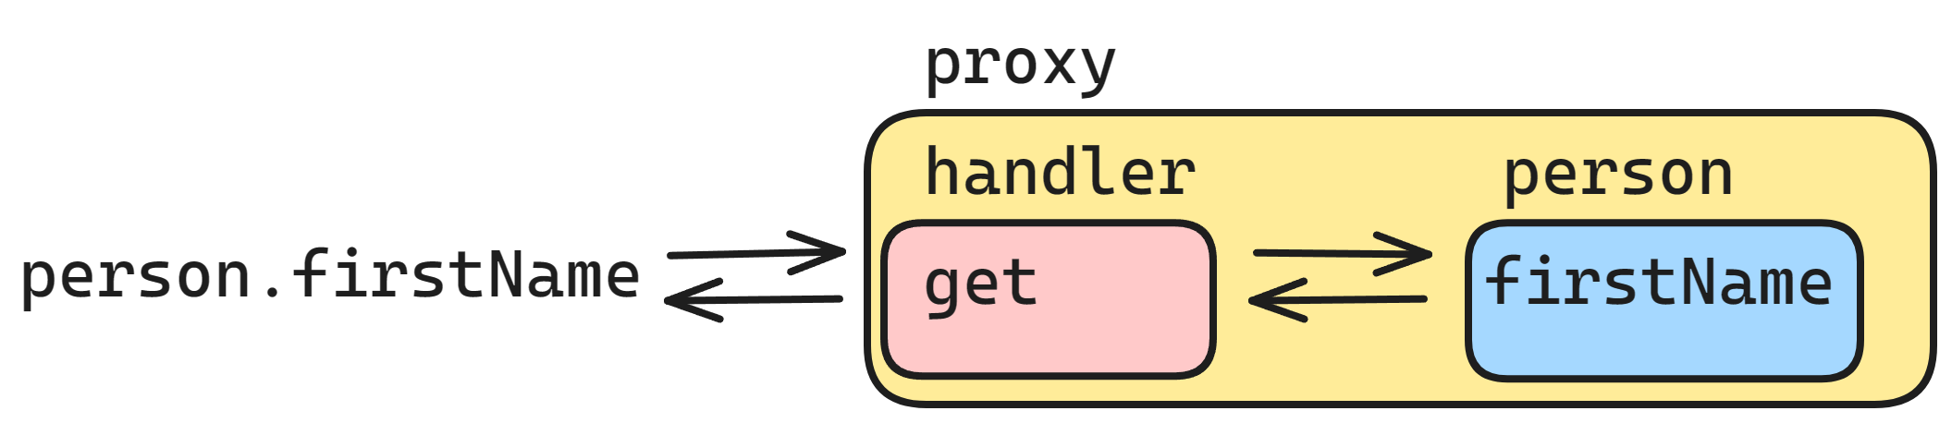
Proxy

Slide 7
Internal Method | Trap/Reflect | When
[[Get]] | get | Reading a propery
[[Set]] | set | Writing to a property
[[HasProperty]] | has | in operator
[[Delete]] | deleteProperty | delete operator
[[Call]] | apply | function call
[[Construct]] | construct | new operator
[[GetPrototypeOf]] | getPrototypeOf | Object.getPrototypeOf
[[SetPrototypeOf]] | setPrototypeOf | Object.setPrototypeOf
[[IsExtensible]] | isExtensible | Object.isExtensible
[[PreventExtension]] | preventExtensions | Object.preventExtensions
[[DefineProperty]] | defineProperty | Object.defineProperty(ies)
[[GetOwnProperty]] | getOwnPropertyDescriptor | Object.getOwnPropertyDescriptor for..in Object.keys/values/entries
[[OwnPropertyKeys]] | ownKeys | Object.getOwnPropertyNames/Symbols for..in Object.keys/values/entries

Slide 8
Useful proxies & proxy limits
Has proxy
Validating proxy
Observable proxy
Recursive proxy
Internal slots
Equality checks
Context sensitive

Slide 9
What’s this?
let proxyPerson = new Proxy(person, handlerOne);
proxyPerson = new Proxy(proxyPerson, handlerTwo);
...

Slide 10
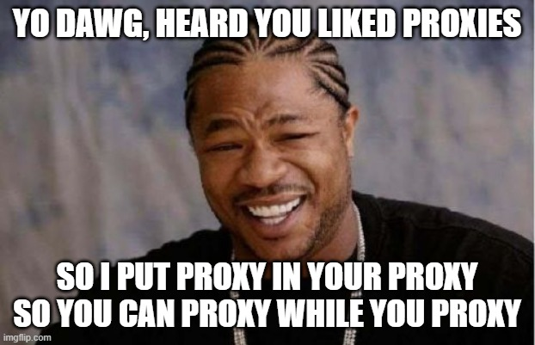
Proxy Proxy

Slide 11
What’s this?
export class Person {
constructor(firstName, lastName, age) {
this.firstName = firstName;
this.lastName = lastName;
this.age = age;
this.address = new Address("n/a", -1, "n/a");
}
print(): string {
return `${this.firstName} ${this.lastName}, ${this.age}`;
}
};

Slide 12
What’s this?
Proxy = new Proxy(Proxy, {});

Slide 13

INCEPTION

Slide 14
Questions
Default value?
Readonly property?
Hide a property?
Memoization?

Slide 15
Answers
Default value? | get
Readonly property? | set
Hide a property? | get, ownKeys, getOwnPropertyDescr.
Memoization? | apply

Slide 16
Lessons learned
What is a proxy
Traps
Useful proxies
Proxy limits
Recursive proxy
Proxy proxy
Inception

Slide 17
Final though
Not everything that saves lines, saves time.

Slide 18
Sources
Repo: GoranSiska/FunWithJsProxies (github.com)
Specs: Proxy - JavaScript | MDN (mozilla.org)

Slide 19
This is not school, but we
love to get grades. Please fill out our
questoineers and leave
us your feedback. You may even win some
cool rewards.

